Slide 1
Analysis of Adaptive Incentive Protocols for P2P Networks
Bridge Q. Zhao, John C.S. Lui, Dah-Ming Chiu
The Chinese University of Hong Kong
MobiComm 2009

Slide 2
The Problem
Propose a general analytical framework to analyze and help to design incentive protocols for P2P networks
The framework has the following parts:
  Generalized P2P incentive model which contains the basic assumptions of the system (such as there are finite number of strategies)
  Learning model for how the peers to get information about the environment
  Incentive Policies

Slide 3
Background and Motivation
Incentive protocols are crucial for the overall P2P system performance.
No work on analyzing the generalized performance of incentive protocols.

Slide 4
Approaches
Learning models:
  Current-best learning model (CBLM): find the current best incentive strategy to use
  Opportunistic learning model (OLM): in each round, each peer randomly choose a ‘teacher’. If the teacher has better performance, then switch to its incentive strategy

Slide 5
Approaches (cont.)
Incentive Policies:
  Mirror incentive policy: the peer who served more will also receive more service from others.
  Proportional incentive policy: each peer has a ratio of contribution/consumption and the probability that peer can get served is derived from the ratio.
  Linear incentive policy: use a matrix to represent a family of incentive policies. Can be viewed as a more generalized incentive policy.

Slide 6
Techniques
Because the proposed framework has a lot of parameters, there are a lot of mathematics involved in calculating the performance.
However, only the basic mathematical knowledge is needed to understand the paper. The major techniques used is engineering mathematics including calculus and linear algebra. Some probability theory is also used.

Slide 7
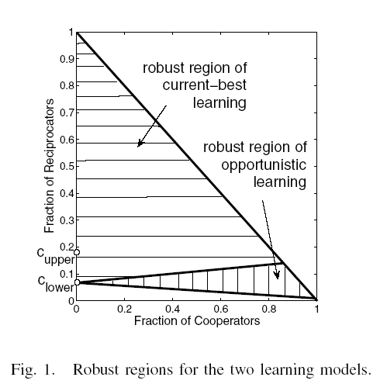
Results and Findings
Mirror incentive policy is not as robust as proportional incentive policy.

